Slide 1
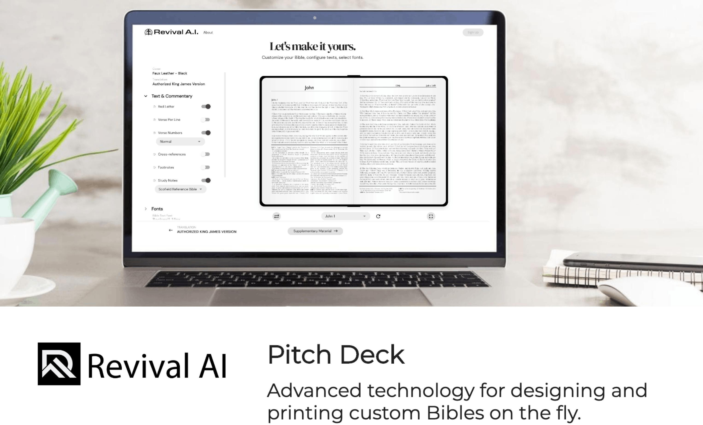

Slide 2


em
O
Formatting and designing a new Bible is a complex process in which
professionals spent months or years on each new product.
The inbust has failed to adapt to the future of procluct customization. This has resulted in a customer-base that is unsatisbeb, as consumers increasingly bemancl inclividualizeb proclucts.
Bible publishers continue to use out-bateb, hand -bone bnishin processes that are timely, costly and error- prone.
Cost Bibles today are low quality ancl mass printed in China.

Slide 3
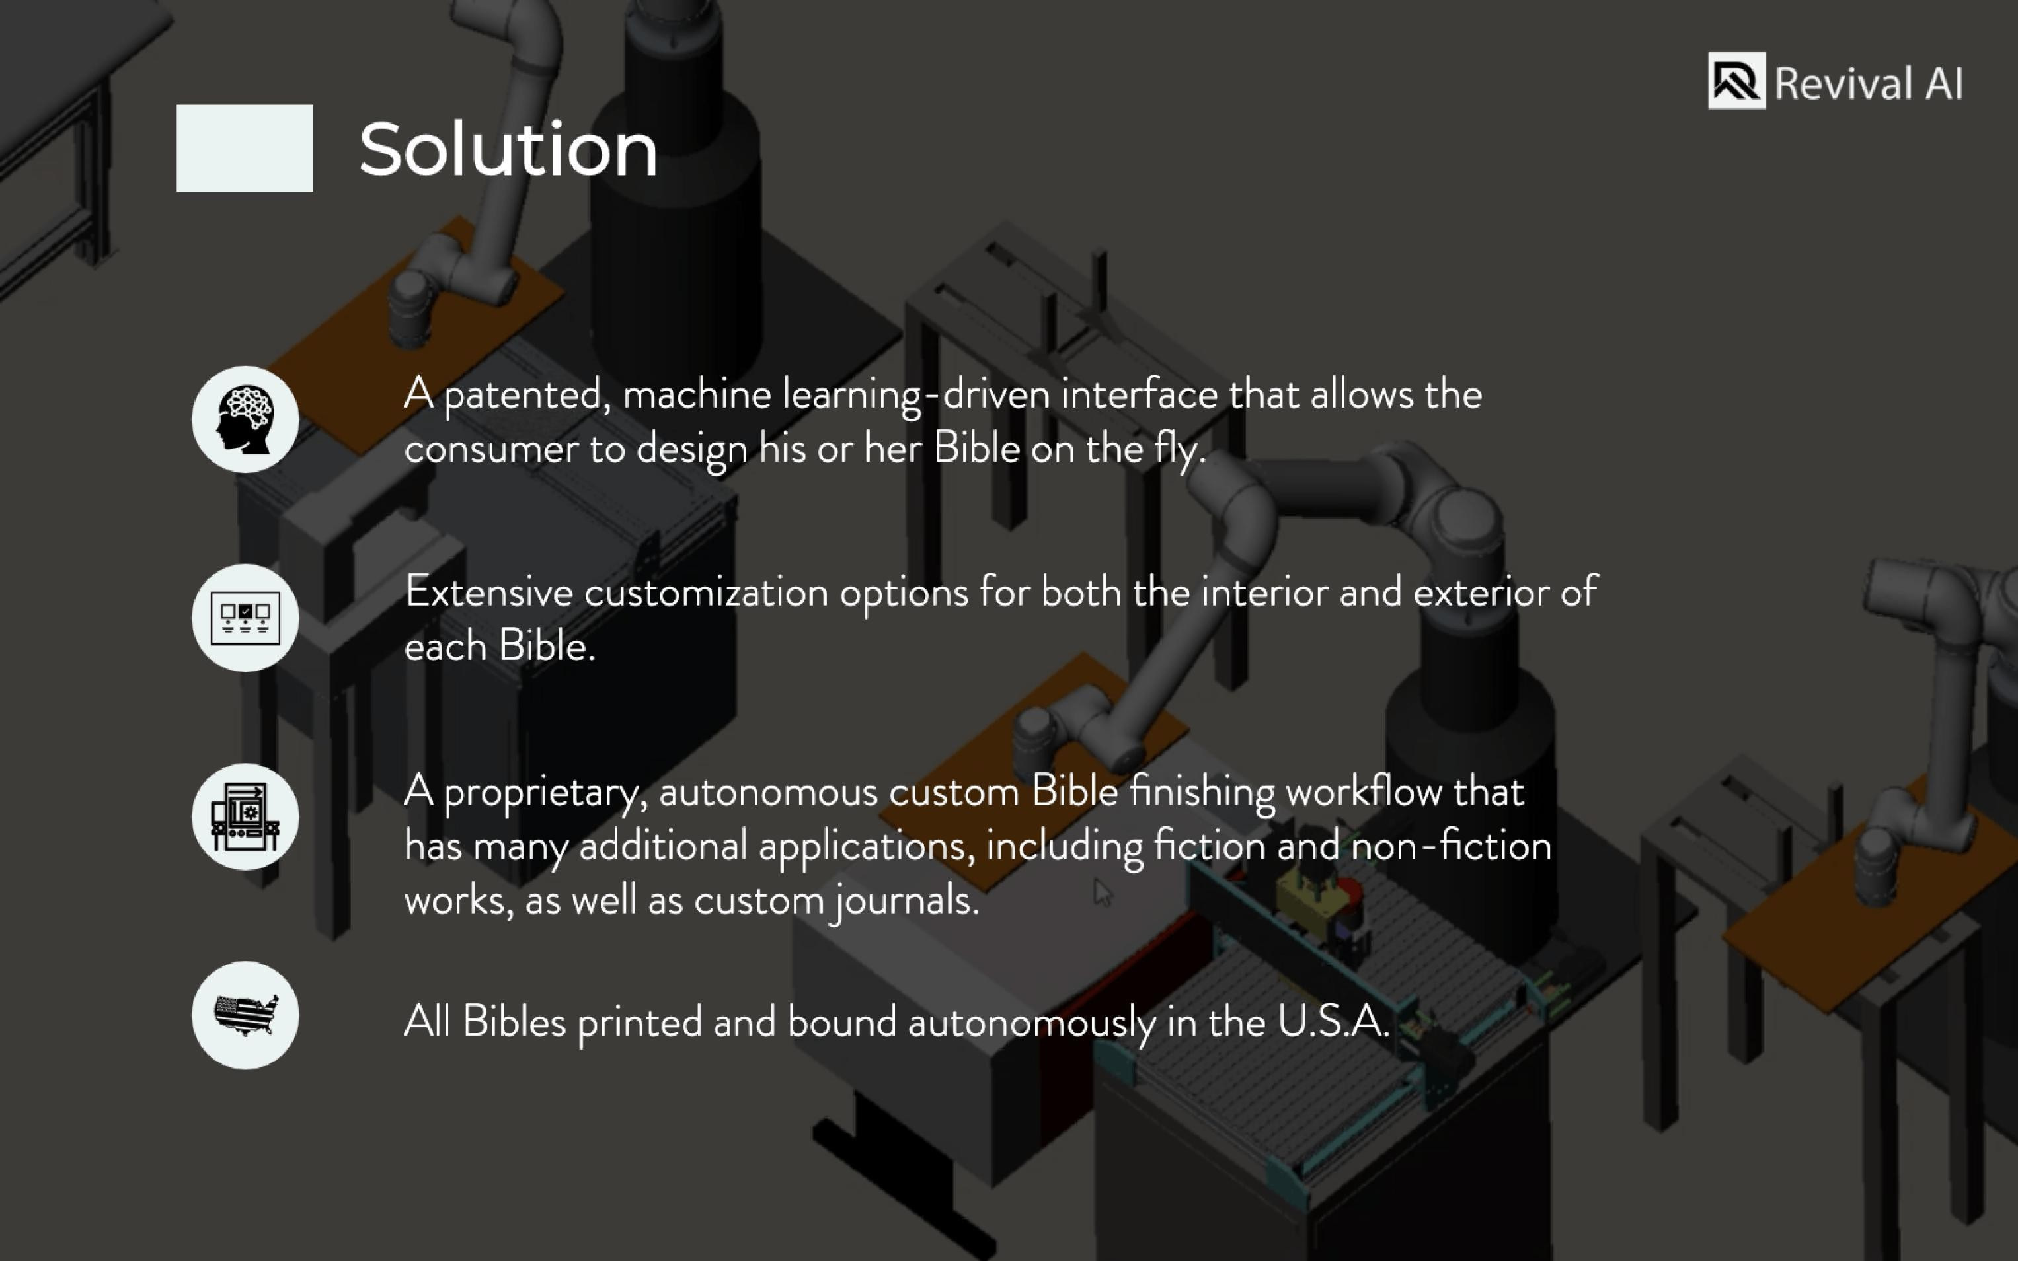

Slide 4


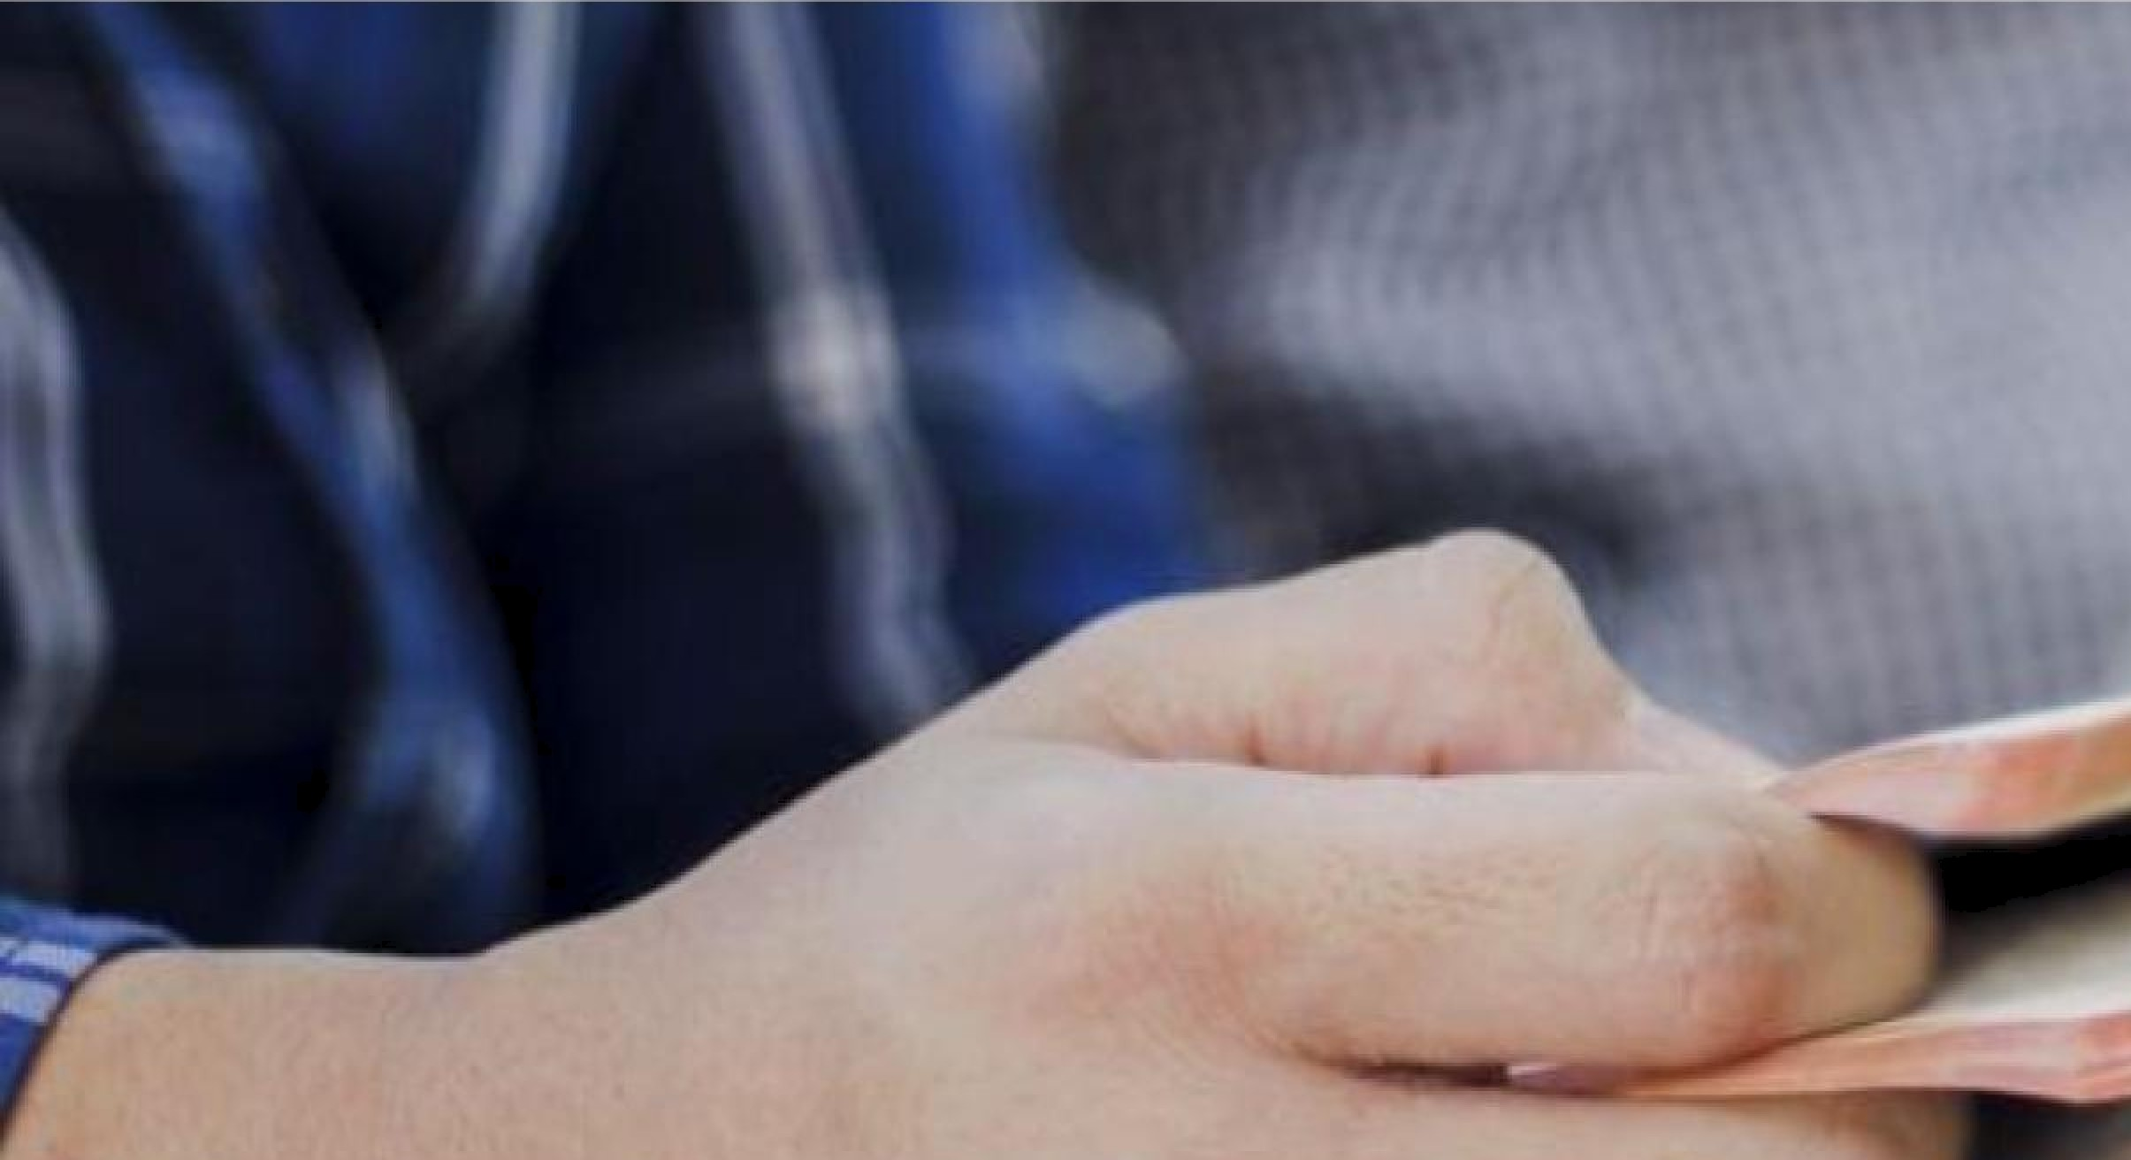

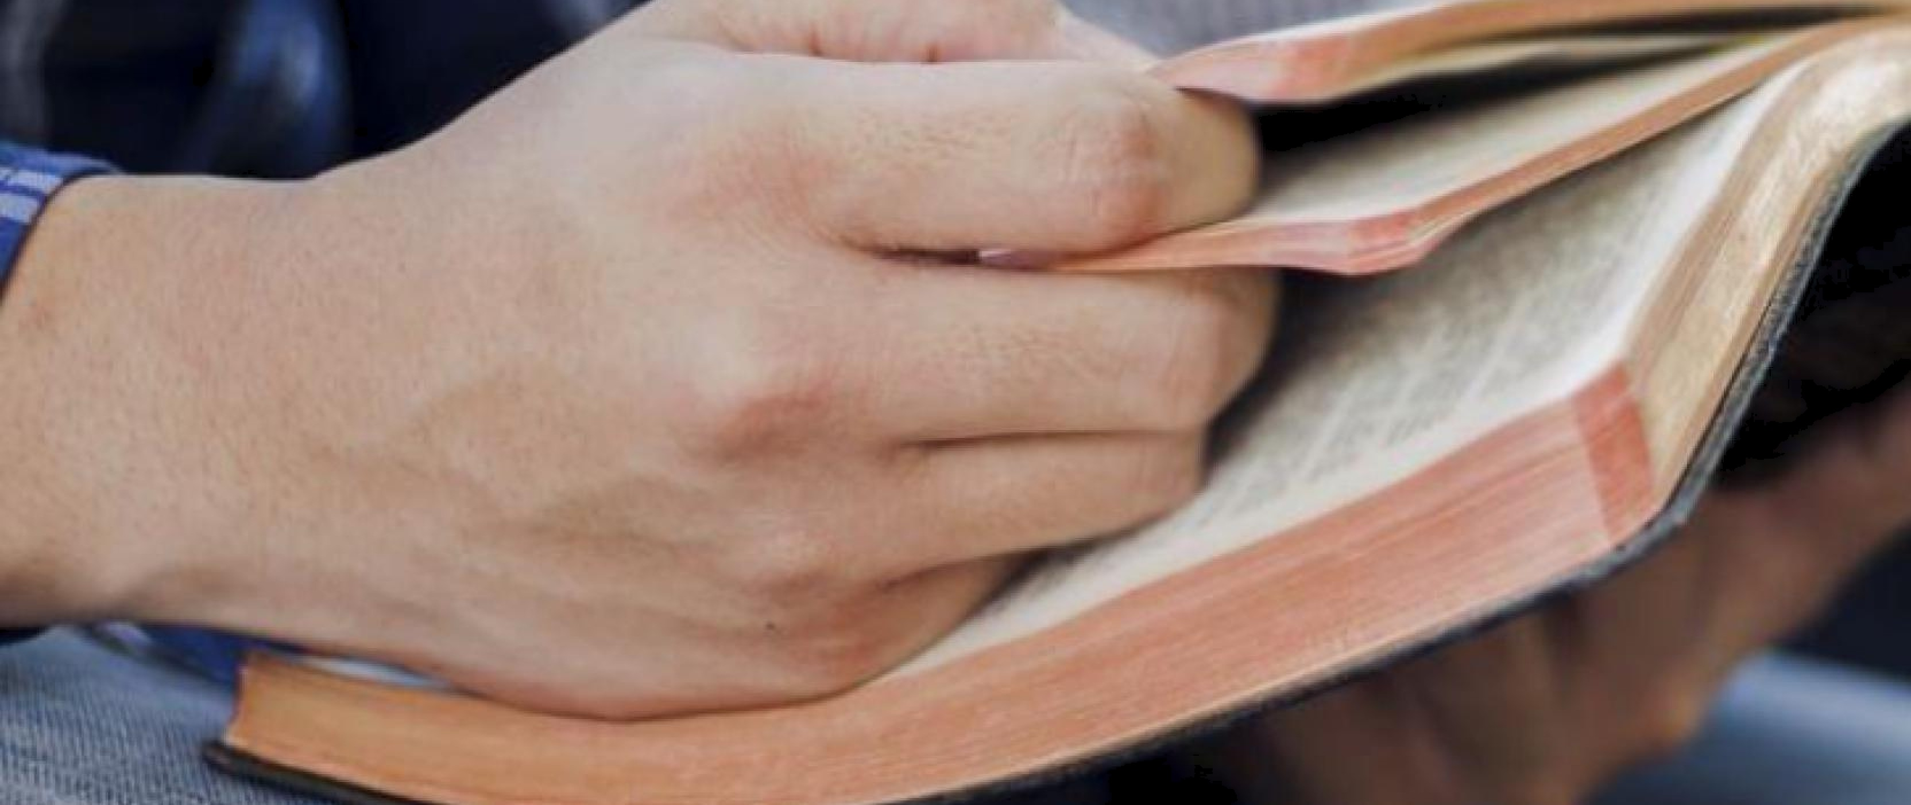
Revival AI
ar
flñe BiDle continues to be the best-selling book of all time.
/Vtost Bible users ( ^{y on}o) S#i(I prefer to use a print version of tñe Bible over Digital alternatives (Barna).
80% of consumers are more likel{ IO Do business witñ a company if they oDer customization o/t.ñeir products (Epsilon).
-.
.
‹ _
"

Slide 5








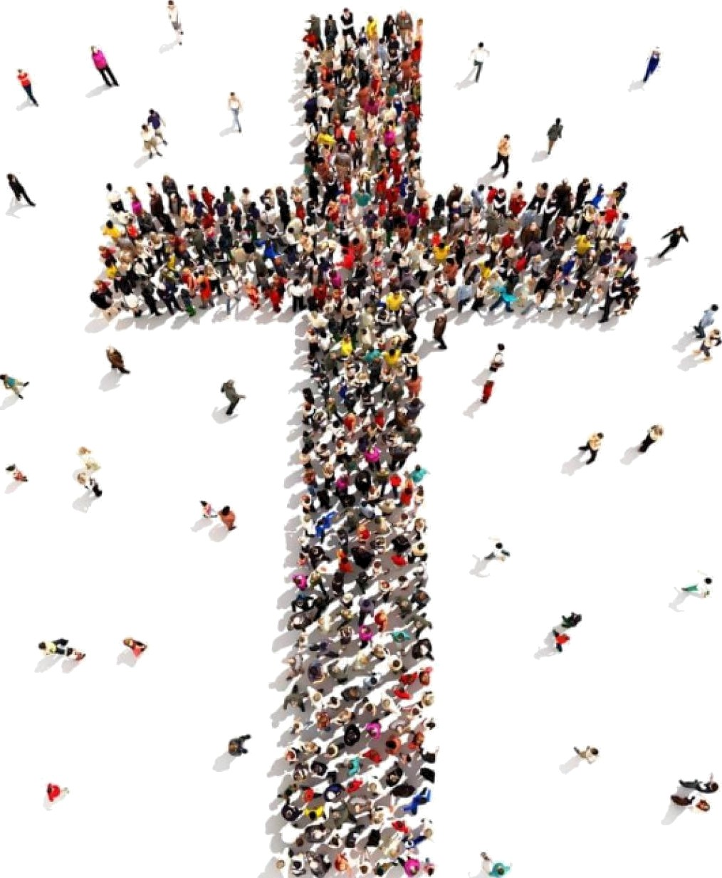












Revivai AI
et i
Over llion Bibles are printed per)/ear;
2/^{O}7*o sold in the .I?.A.*
$42!â
lion in annual U.S. Bible sales*
$50
global market
llion:
0% share
‘ñttps://brondongoille.coml27-good-bible -soles-stofiisfics/

Slide 6
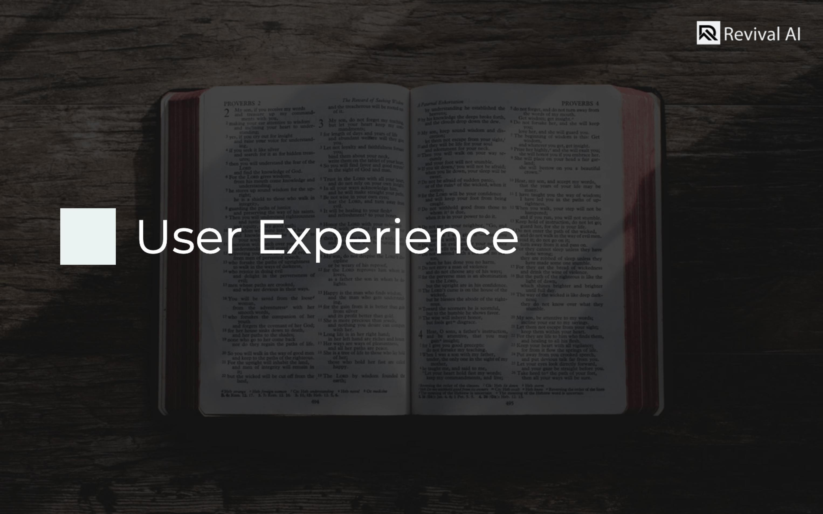

Slide 7




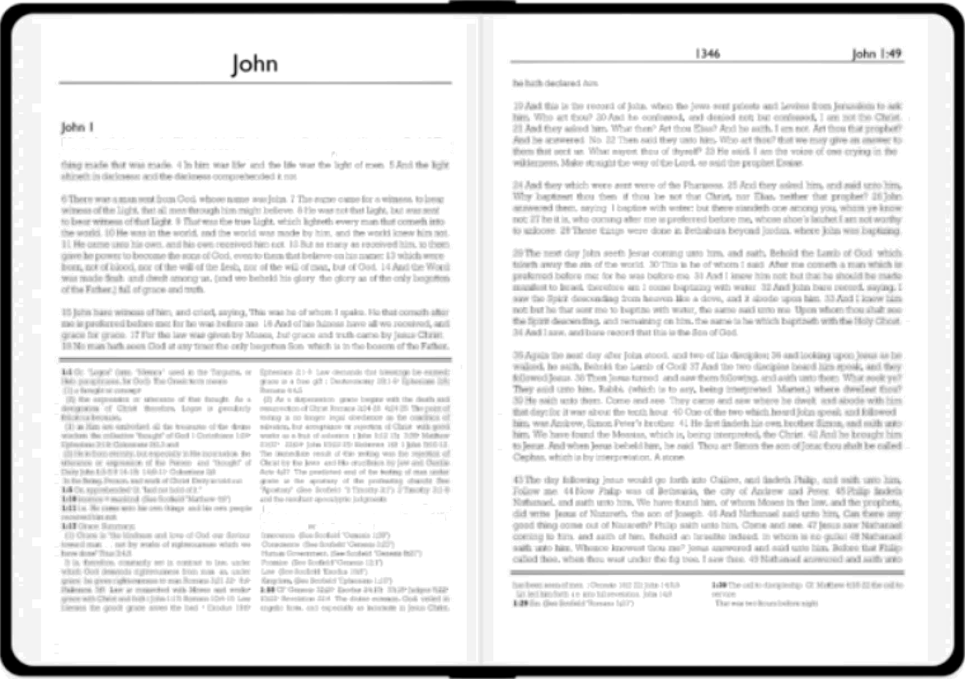












Customize your Bible, conf.igure texts, select fonts.
Faux Leather - Black
= Text
Red
Letter
Verse
Per Line
V»rsa
Numbas
Cross -references
Footnotes
Notes
Scofietd Reteence Bib4 •
FonQ
"" AUTHORI2ED
VERSOH
* 2O2Q Revival &I
Tomms ot Se‹v‹c e Privac Y Polic Y

Slide 8
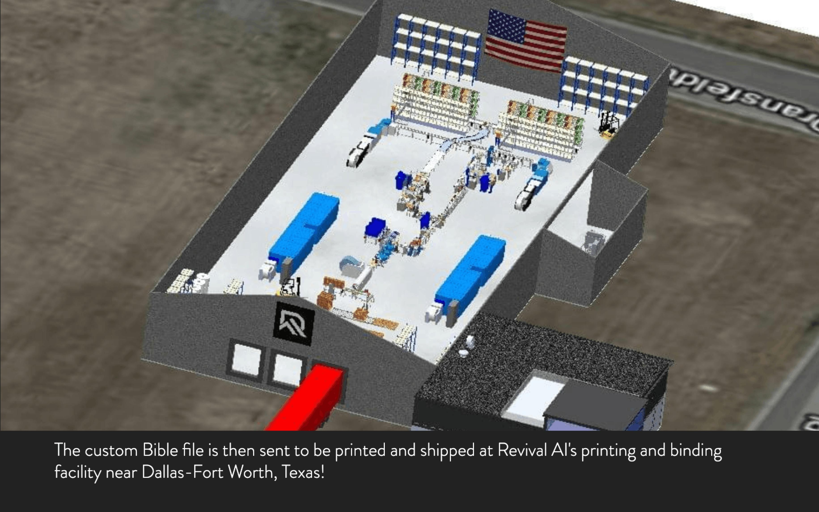

Slide 9
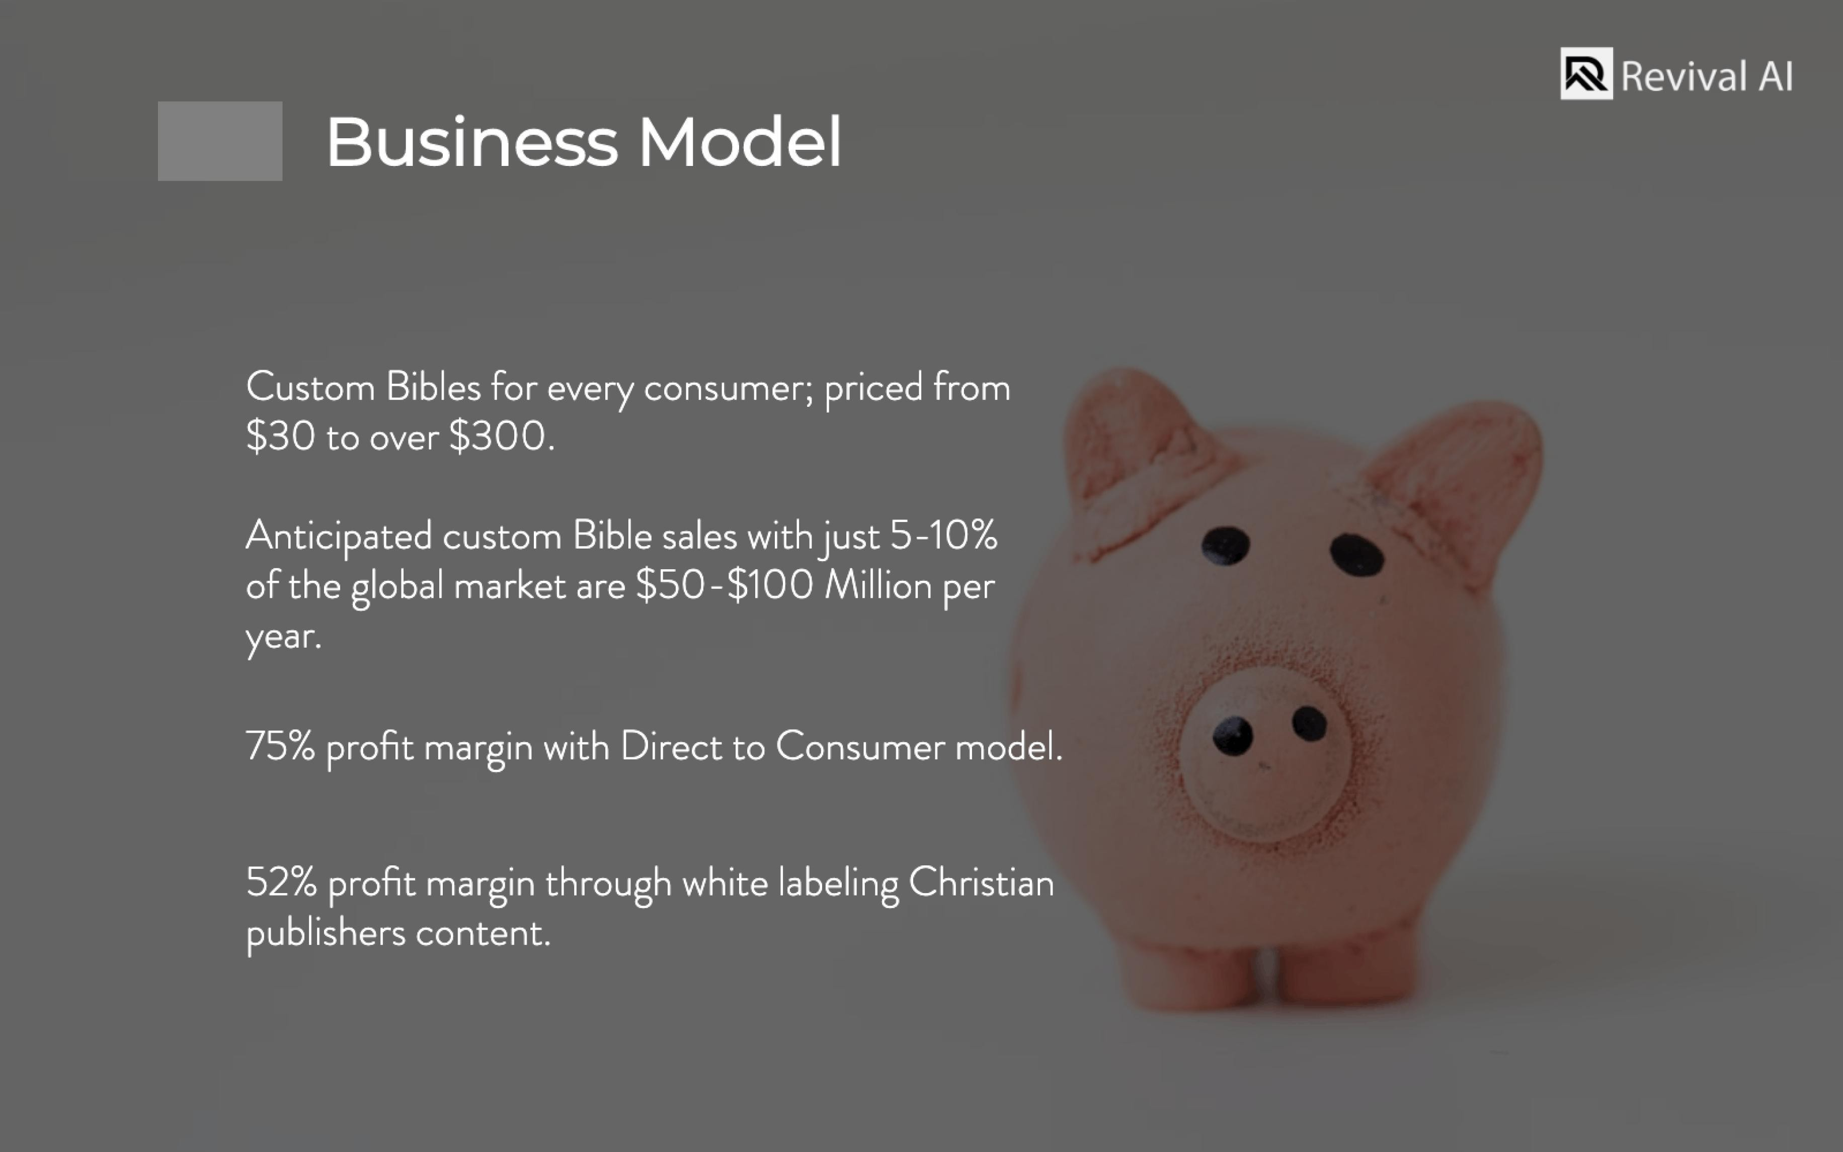

Slide 10


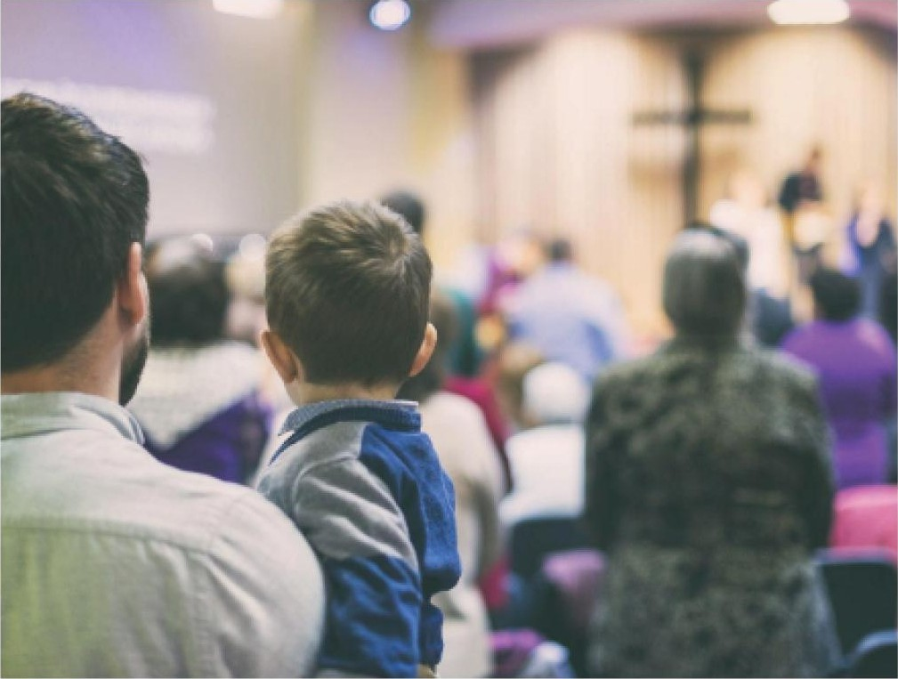

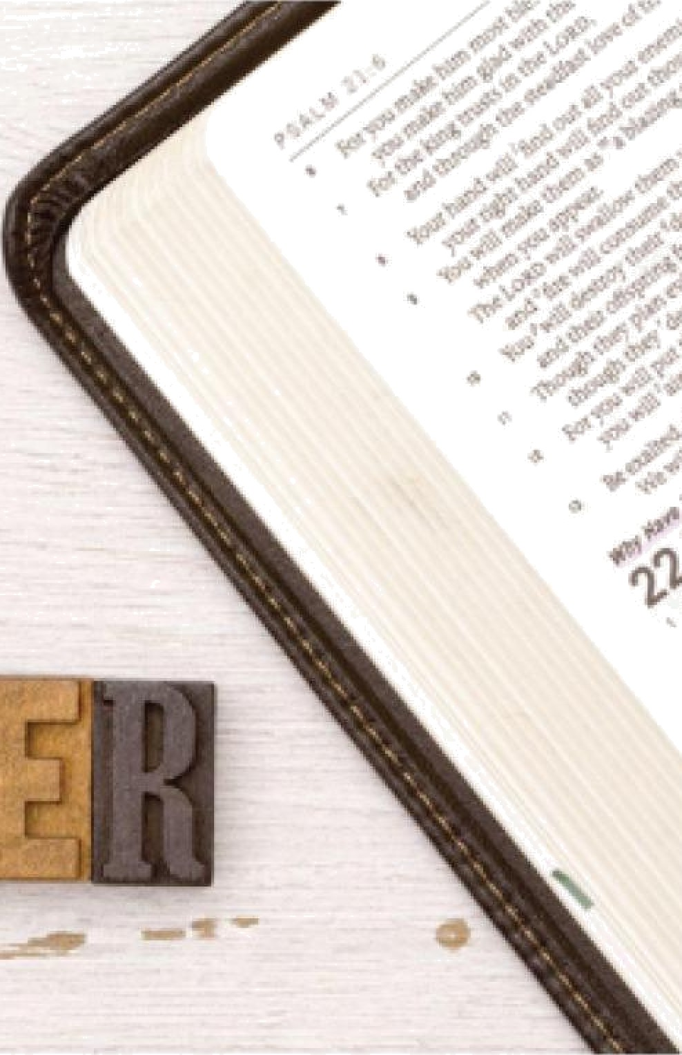



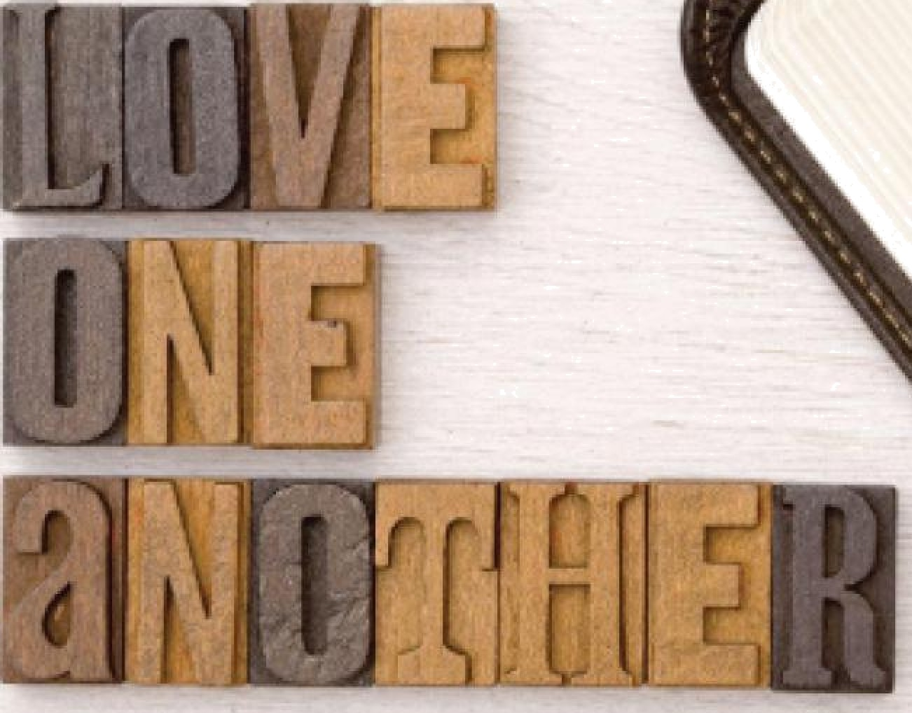




ion
Revivaİ AI
ar
*.",."₋.....î..'_{ț}'_{ï}q*._{-.}ź_{.°.J‹}¿.,,›.".„...,_{R.}t.,:,...,_{č}...
.....,.Ț.....,.„..°,î......*,..,:,›.*.°.
... .....
..,.
ø‘
ś*
( .’ĞwȚ cțȚJ@ Î**.....’. .’.I ..’¿Ț/ø
-•
» 1
-
AFF LIATES: Pastors, ministries
anÚ everyday ČŃrÌstians can
WHİTE LABEL: Čhristian
publishers license Revi'vaİ A 's
Ï?eChnology; significantly increasing their profit margins, while bringing printing back to the Ü. .A. mom Čhina.
VING BACK: 10⁰/»of
annual profits will be donated to Christian, non-profit organizations or ministries.
€?arn 30% Of r€?Čel"red sales by sharing an aŒliate link on their websites and social media accounts.

Slide 11






















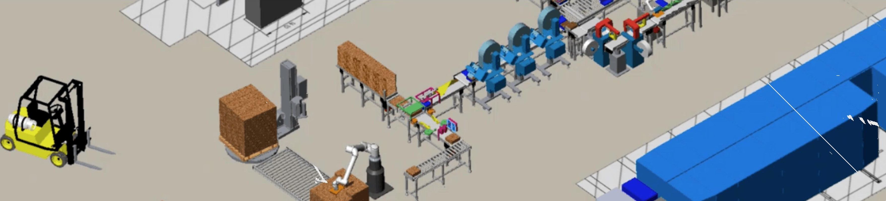
Revival AI
Regulation
Devival Al i seeking custom printing fexas.
nancing to bui
out proprieta
rowdfu
ing Ca
paign
i facility nea
Dal Dort \/\/orth,

Slide 12







Revival AI
IV
Patentezl */*echnologg’
White Labeling
Customer-Designerl
Speed
Revival Al's soft:ware is patented in tbe U./. anrl patent - pending in
Tbe onl)z way for competitors to enter tlne custom Bible mar!<et is through licensing with Revivai
AI.
/?/ur machine - learning driven interface allows eacb consumer to build exactly what the'/ want; increasing overall product satisfaction.
IHig!c quality, smyth - sewn, art-giléeé ! ibles tlnat can be produced same- dam, instead of weeks or montbs to produce.
the (. rovislonal patents bave been filed for our custom finishing mac!niner')/.

Slide 13


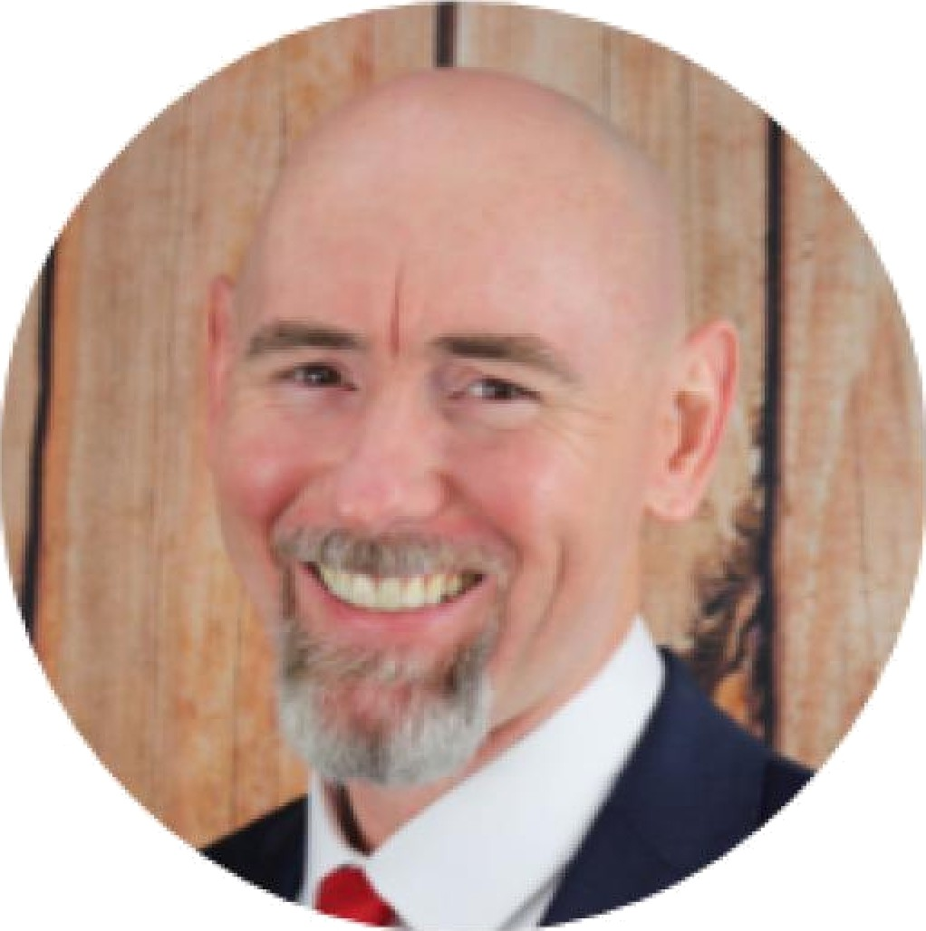
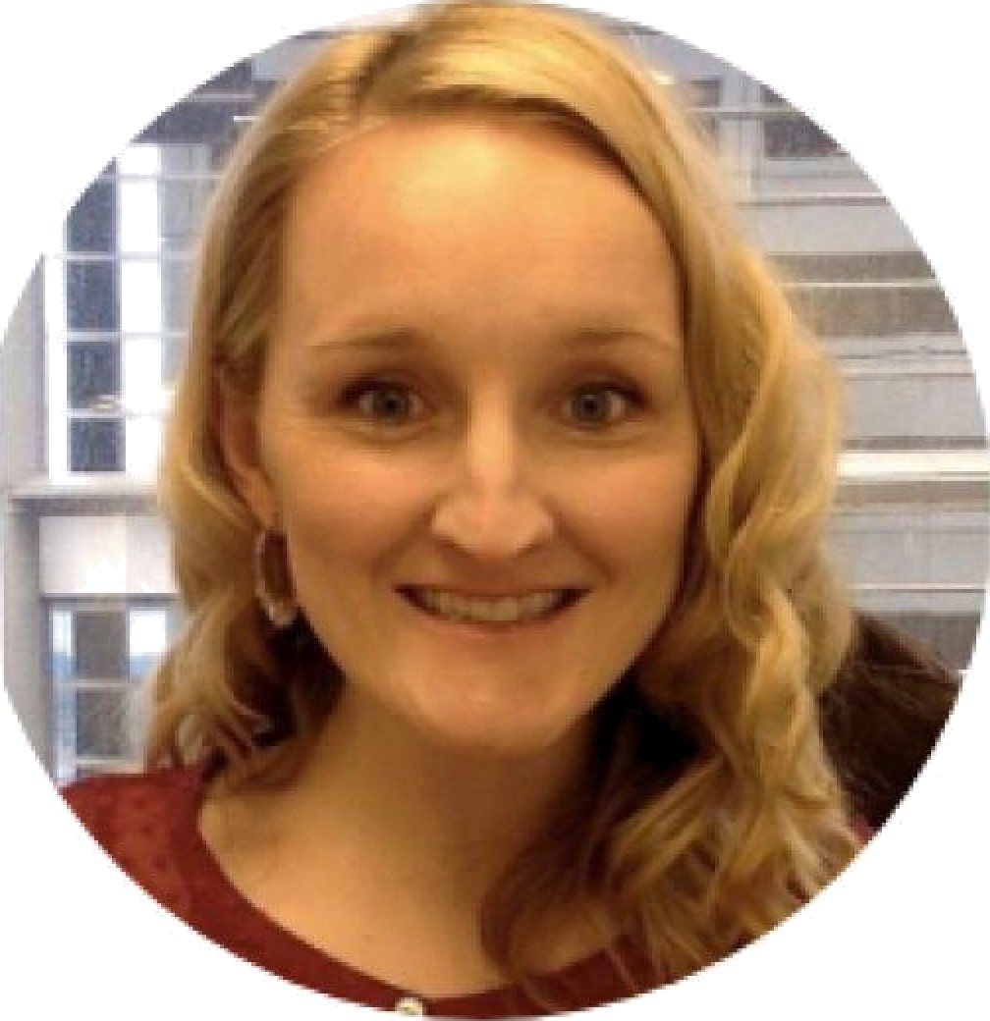
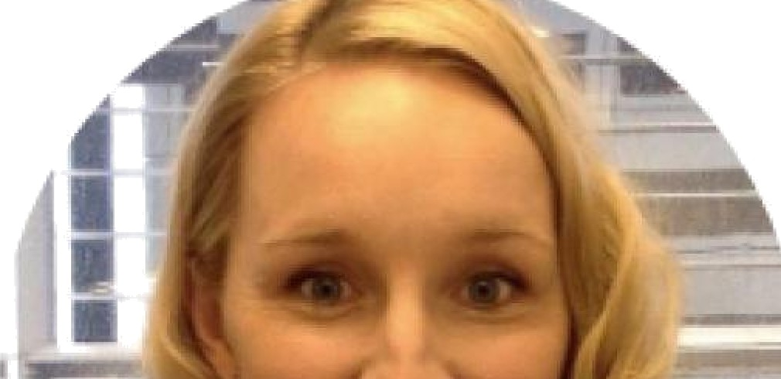
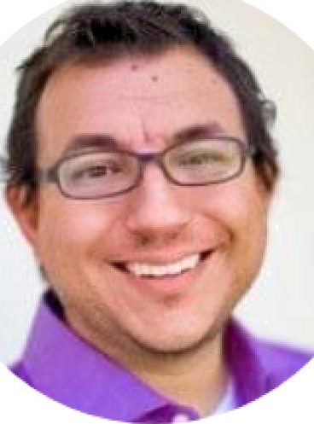

ea ers
Revival AI
NODEL
ROCKBT
William Robinson
I ristin Robinson
Rob Rodriguez
/*/todel Rocket COC
Co-founder and ’CVO
@o- founder anrl @EO
Director and v/WTO
AI/ML, Ui/UX Dev Team
M. Div., fdt.T.S. - Liberty
b‹laptist Theolo{]ical ! eminary
B.S. Chemistry
Over 20 }/ears experience with multiple fortune 300
Extensive experience from Concept to /\/\arket
18 'years oftecbnical sales experience, inclucling 13 )/ears at the industry-leaéer, Schrodinger
Combat Veteran (Afghanistan)
CO ?5 E'
/\/tultiple !?olutions developed that incorporate Artificial Intelligence, /\Machine Learninjg and Data Science
”'* " *
mo-founder and v/ TO,
Rocket
/\ñodel
Qroven leader and mana{]er
mo-founder & President of
Reformation Bible Society’
Co-founder and CTO of
honoring Intimates
loo -founder & 'V'P oF
Reformation Bible Societ'/
mo-founder and CEO of
Honoring Intimates
Developed a neural-net based
OCR and an imayte compression library useé by ma_{J}or social media networks
Holds 19 |]ranted patents
Industries worked in:
/\/tedicine, loT, Hospitality,
eCommerce, Agriculture, Enterprise, Education, Government, Finance
Patenter/ Inventor
Pstentecl Inventor

